Slide 1
Computer Vision Final Project
Student:
b04507009 何吉瑞 b04901021 陳傳諭 b04901022 黃家翰 b04901117 毛弘仁

Slide 2
Outline
Challenge
Approach
Enhancement of methods in hw4
Extensions on this project
Results
Acknowledgement

Slide 3
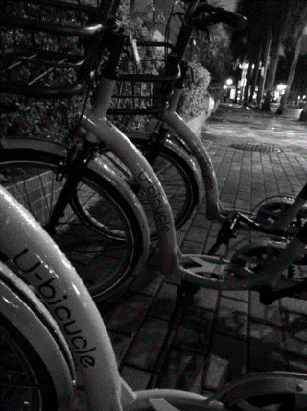
Challenge
Repeated pattern in real data
Unknown range of disparity
Extreme value in occluded region

Slide 4
Approach
Matching cost
Use normalized AD cost and census cost with a large window size
Cost aggregation
Extend arm for each pixel
Refinement and optimization
Find outlier by comparing the disparity maps from L to R and R to L

Slide 5
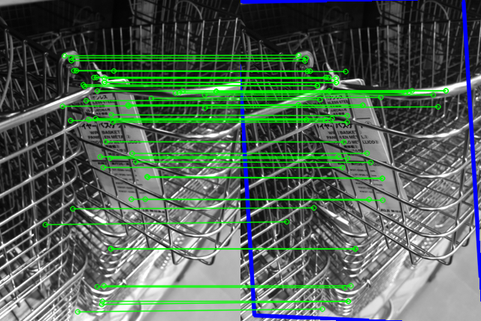
Approach
Estimate disparity map by using SURF
Apply image segmentation for enhancement

Slide 6
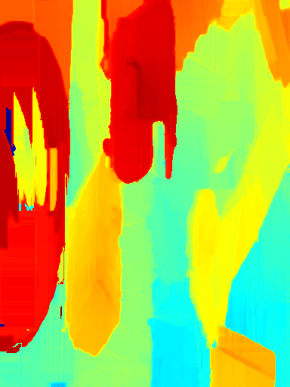
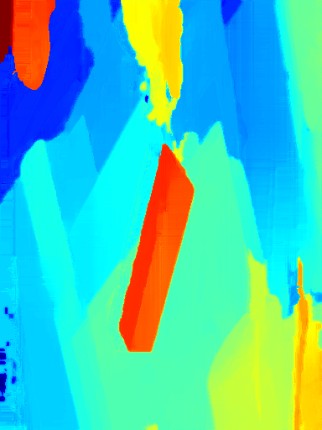
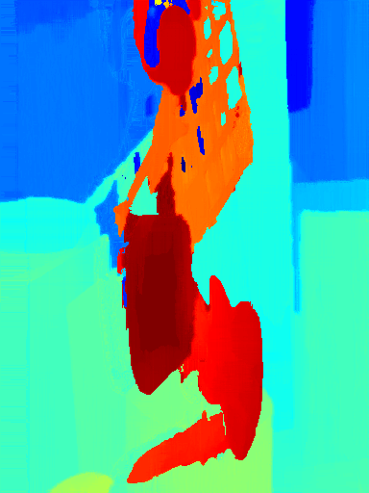
Results

Slide 7
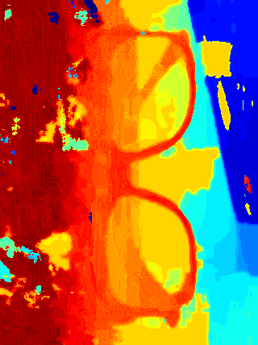
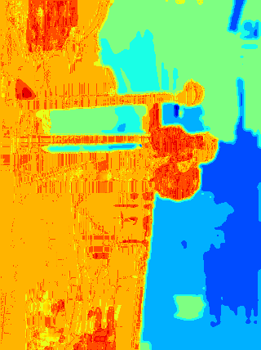
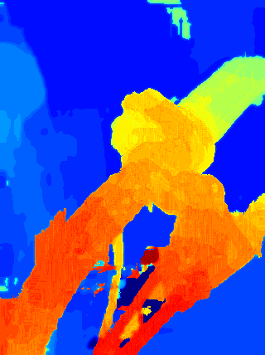
Results

Slide 8
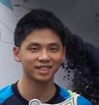
Acknowledgement

